Slide 1
Earl deck template
Sentence case · Funnel Display + Geist Light · Light and dark masters

Slide 2
The AI partner for elite sports and stadia.
Pitch deck · May 2026

Slide 3
Built for the venues that bring people together.
Pitch deck · May 2026

Slide 4
Section 01
Why now.
Two big shifts are colliding. The commercial pressure to find new revenue beyond core business, and the rewiring of how people discover, buy and consume.

Slide 5
Section 02
What we do.
We embed AI tools into commercial operations, broker how AI uses your data, and design new experiences inside AI itself.

Slide 6
Our bet
Services on the surface. Software underneath.
AI isn't a feature of what we sell. It's the operating system that lets a smaller team deliver at the scale and margin of a software company.
Targeted, AI-native pods that replace 10-person agency teams.
Commitments measured in revenue uplift, not hours.
Proprietary tooling owned by Earl and improved every engagement.

Slide 7
The team
Three expert founders.
A decade across elite sport, AI engineering and commercial growth. Built and exited agencies. Sold software inside commercial teams.
Embedded in commercial operations of elite sport rightsholders.
Two decades shipping software inside commercial teams.
Strategy and ABM operators with proven exits.

Slide 8
The economics
Services business. Software margins.
Anchor client · annual value
Why margins look like software
£350k
35-40%
ARR per mature anchor. £120k retainer plus £230k in projects, builds and data deals.
Net margin target at scale. Two-person AI-native pods deliver what ten-person teams used to.

Slide 9
Why now
Two big shifts are colliding.
01 · The commercial shift
02 · The AI shift
Revenue beyond the core.
How people discover, buy and consume.
Broadcast money has plateaued. Matchday is capped. The pressure is on the non-core days, the empty Tuesdays, the unsold hospitality.
Search is moving from Google to AI. Commercial teams that ran on brochures now run on agents. Content will be consumed inside AI.

Slide 10
The next wave of meaningful AI companies may not start by selling software, but by actually doing the work.
Y Combinator · Spring 2026 request for startups

Slide 11
AI isn't a feature of what we sell. It's the operating system that lets a smaller team deliver at the scale of a software company.
Earl founding principle

Slide 12
Let's build the next chapter together.
hello@earl.partners · earl.partners

Slide 13
Let's build the next chapter together.
hello@earl.partners · earl.partners

Slide 14
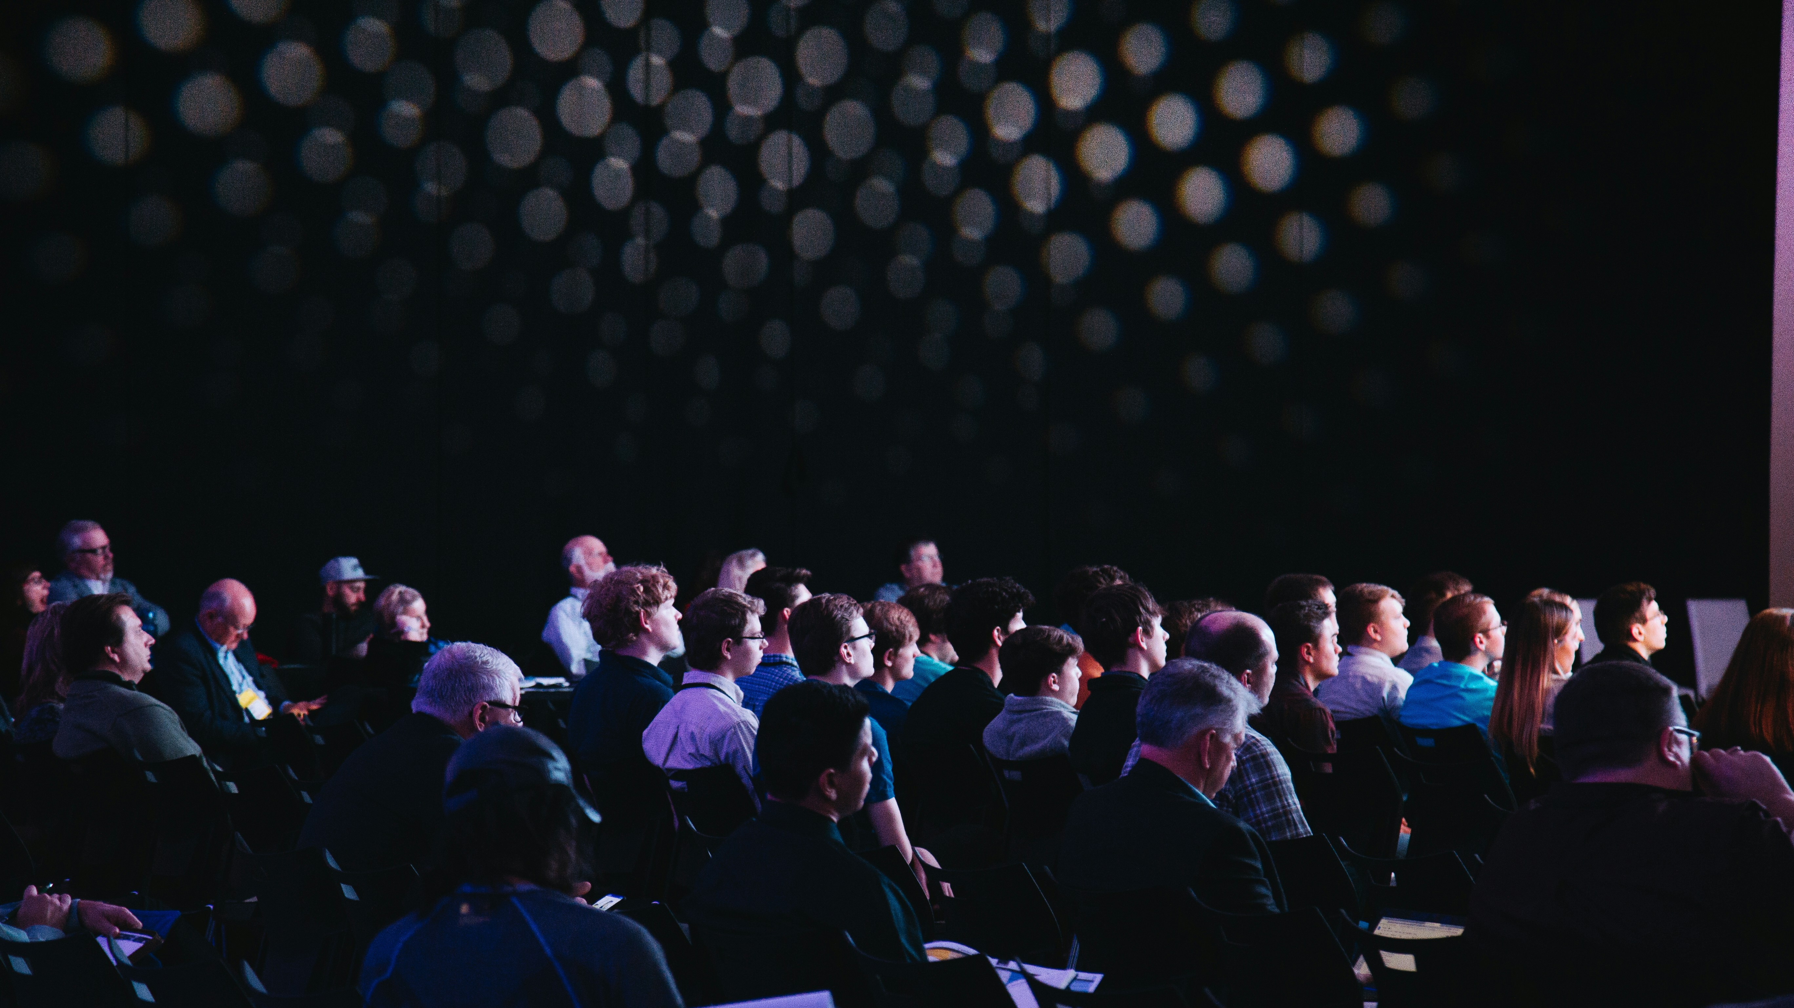

Built for the venues that bring people together.

Slide 15

Why us
Where service meets software.
AI-native pods that deliver outcomes traditionally requiring ten-person teams. Compounding tooling owned by Earl and sharpened every engagement.

Slide 16
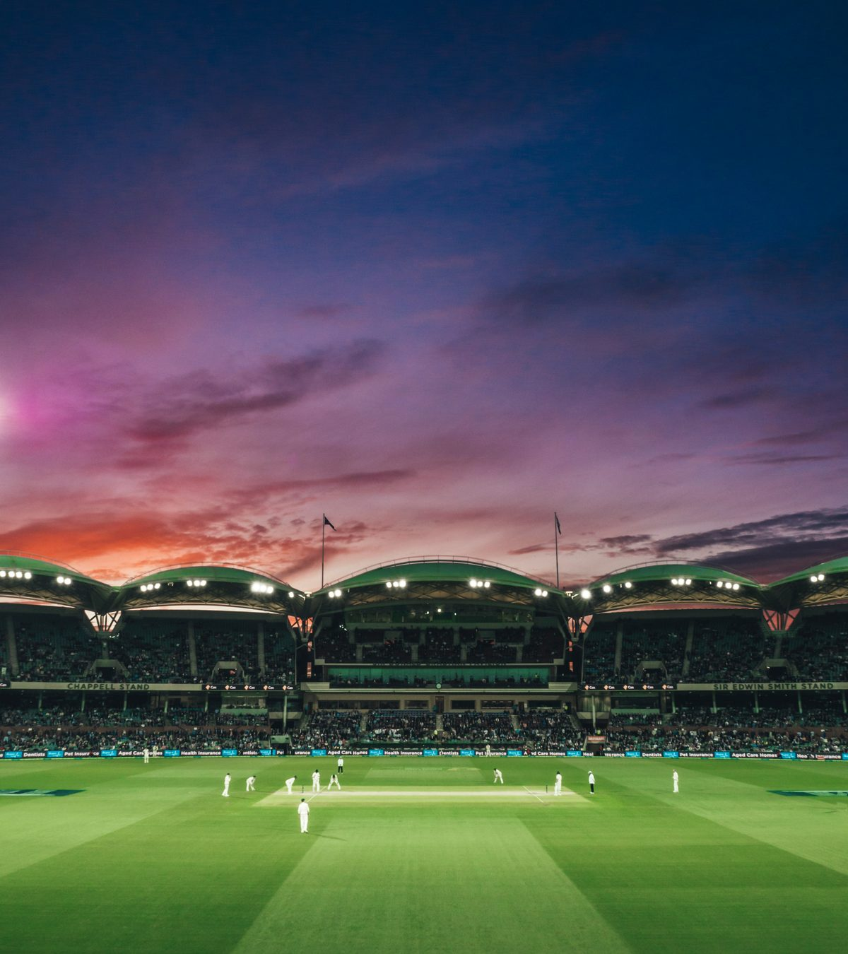
The team
Three expert founders.
A decade across elite sport, AI engineering and commercial growth. Built and exited agencies. Sold software inside commercial teams.

Slide 17
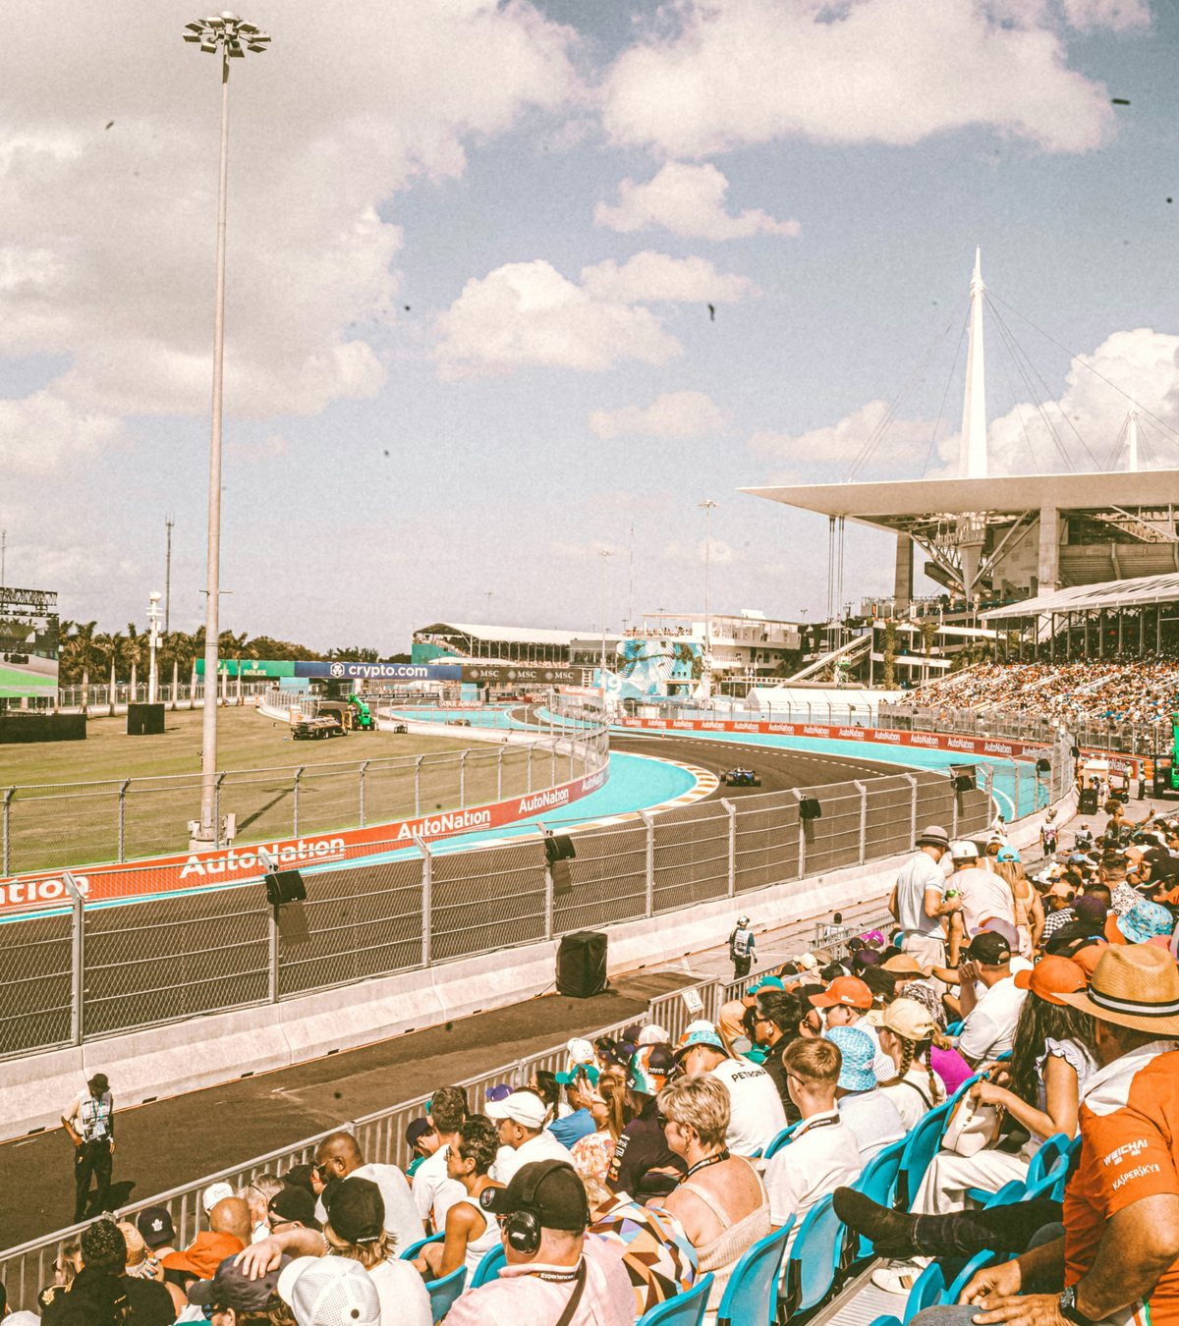
The bet
Services on the surface. Software underneath.
Smaller teams. Software-grade margins. Outcomes measured in revenue uplift, not retainer hours.

Slide 18
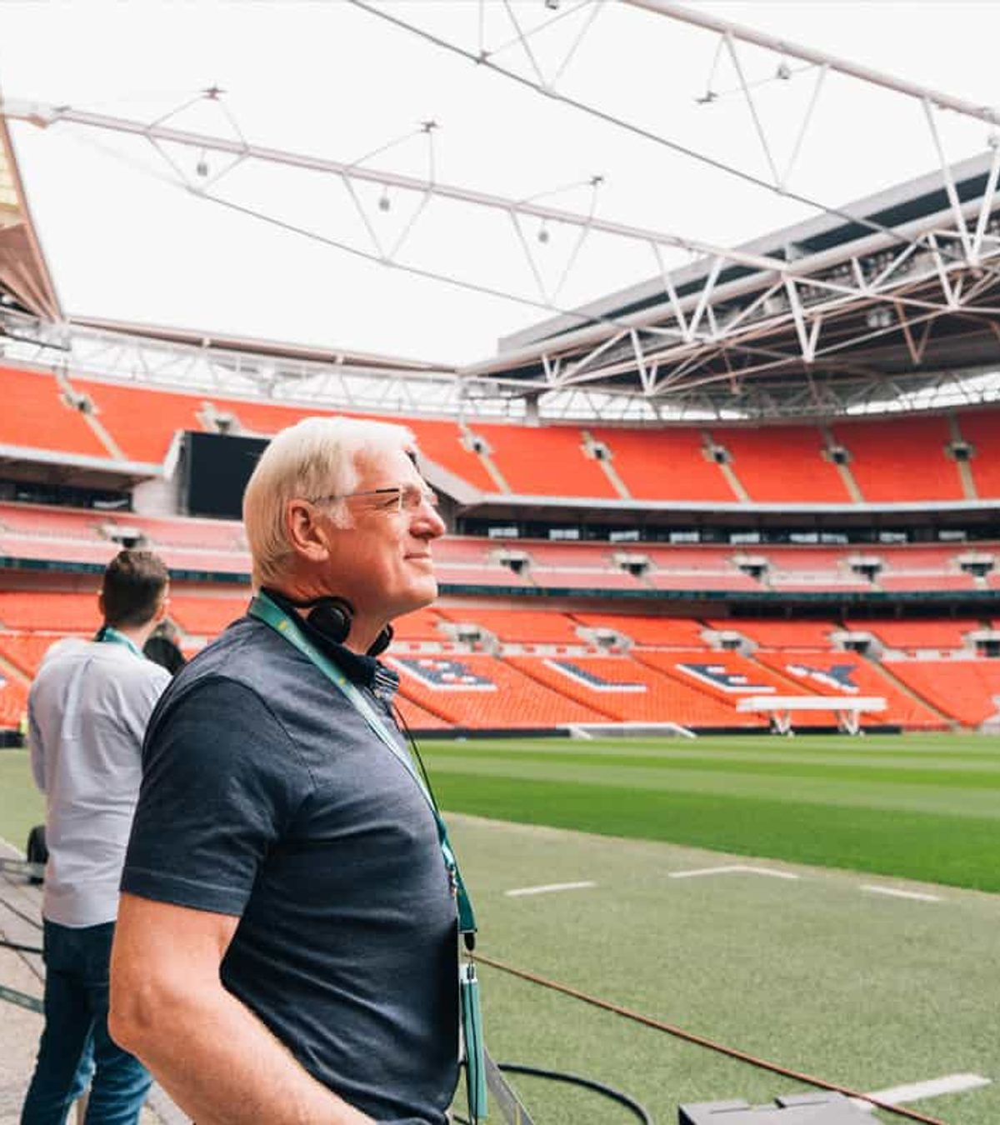
Our approach
Embedded, not delivered.
Pods sit inside commercial teams, not next to them. We build, we ship, we operate. The kit goes home with you.

Slide 19
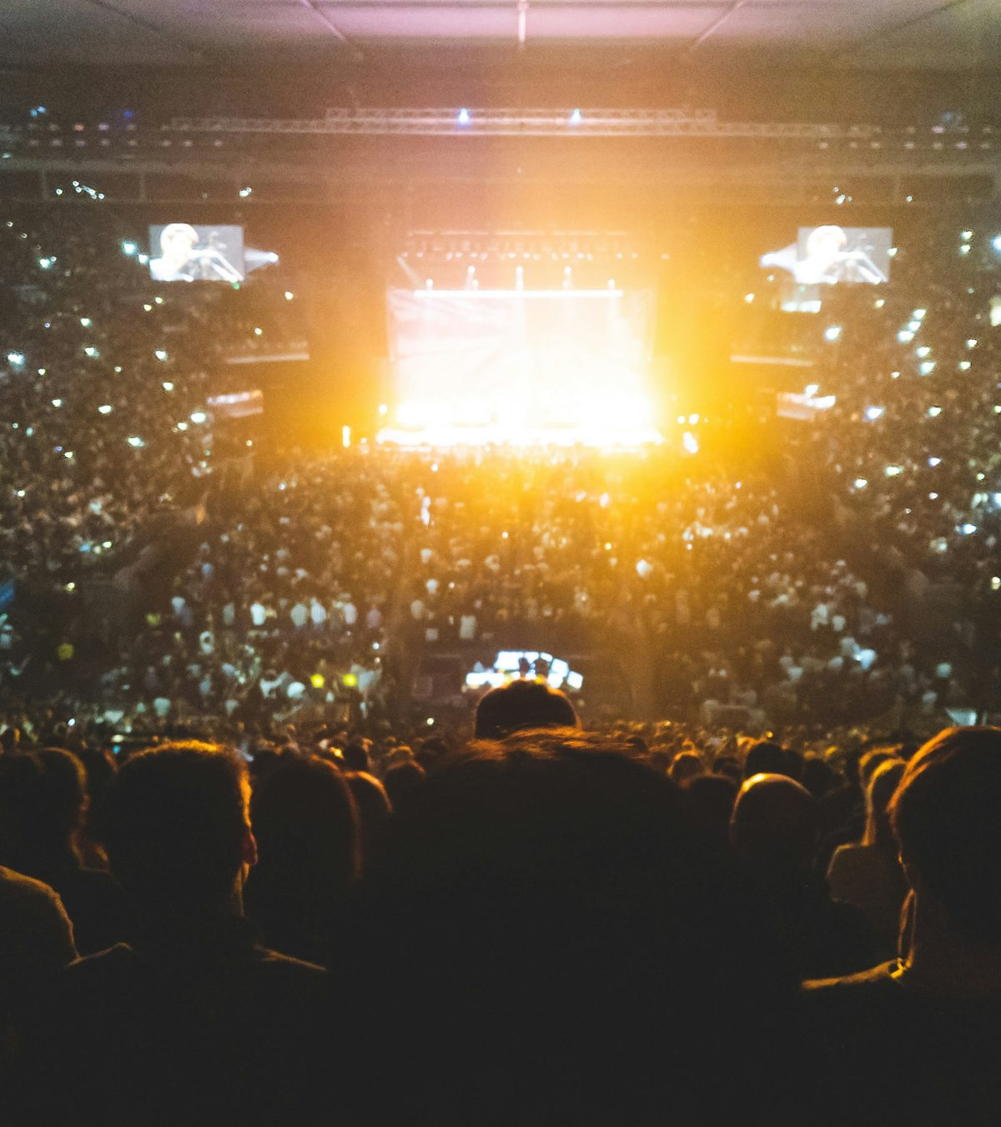
Why now
Two big shifts are colliding.
The pressure to find revenue beyond core, and the rewiring of how people discover, buy and consume - all at once.

Slide 20
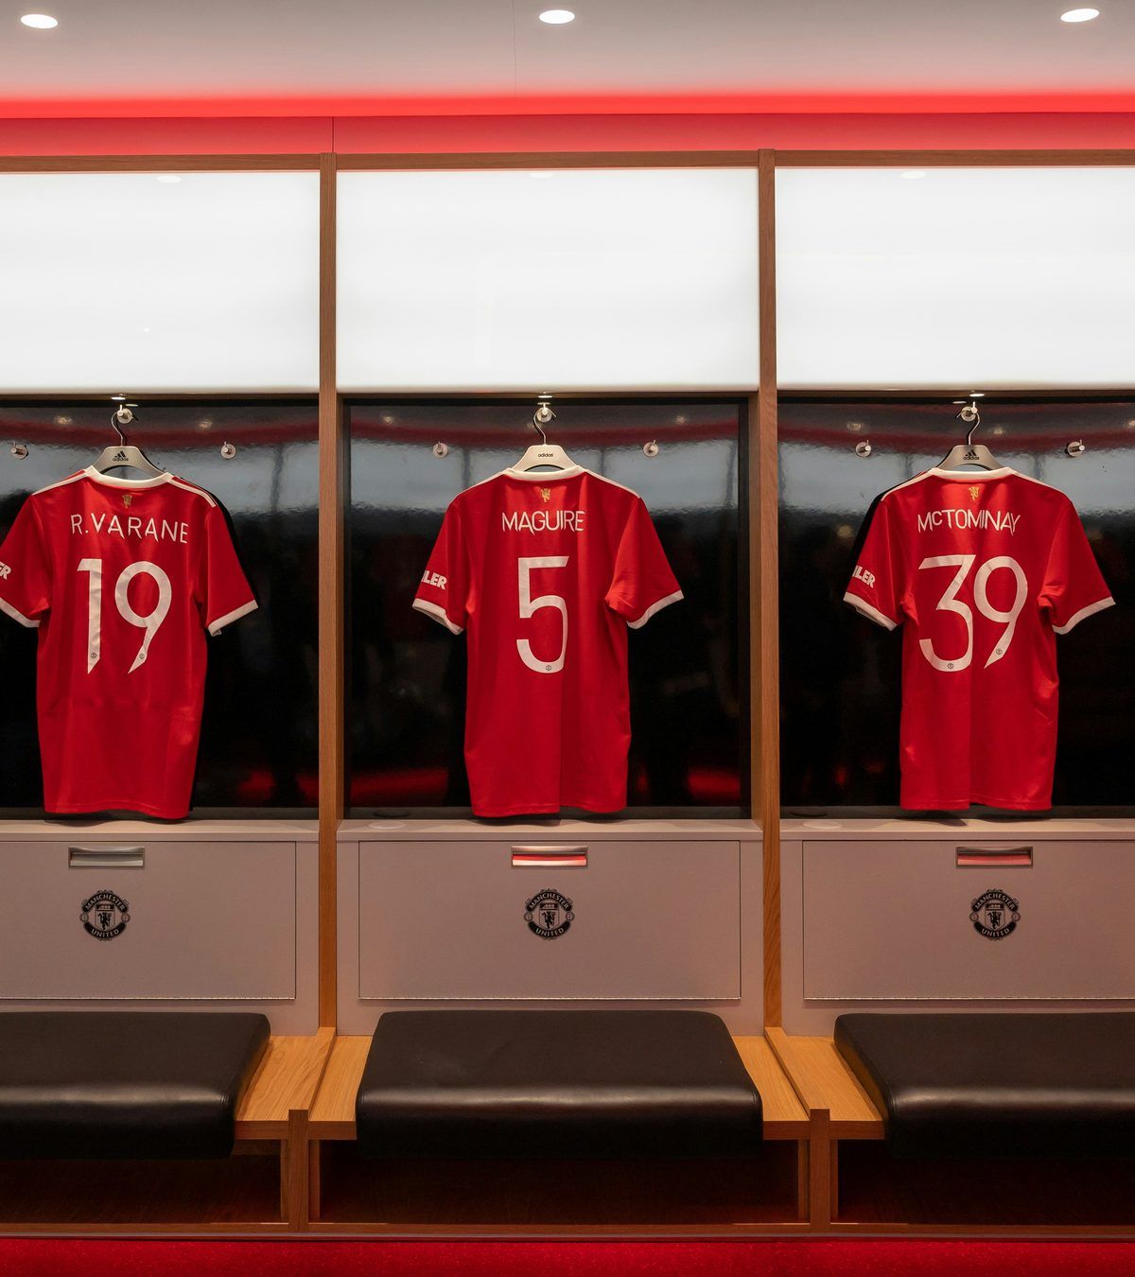
Let's talk
Ready to build the next chapter?
hello@earl.partners · earl.partners

Slide 21
Section 03
What we do.
We build AI tools and systems that sit inside your commercial stack.

Slide 22
Embedded AI
Using AI to gain the edge.
We sit inside your sales, marketing and comms teams, building tools that compound across every engagement.
From bespoke agents to internal copilots, our work ships and gets used. We measure success in revenue lift, not lines of code.

Slide 23
Section 03
What we do.
We build AI tools and systems that sit inside your commercial stack.

Slide 24
AI labs
Experimenting in public.
We share what we learn. Our labs spin up small experiments to test new patterns, then bake what works into the platform.
Recent work: GEO diagnostics, agent-led ABM, AI-native search optimisation, and bespoke retrieval over commercial knowledge bases.

Slide 25
Section 04
About Earl.
Three founders. A decade across elite sport, AI engineering and commercial growth.

Slide 26
Our story
From agency to AI partner.
Earl was founded by operators who built and exited agencies in elite sport, then watched AI rewire the commercial stack underneath them.
We started Earl to do the work the next way: smaller teams, software-grade margins, outcomes measured in revenue uplift.

Slide 27
Section 04
About Earl.
Three founders. A decade across elite sport, AI engineering and commercial growth.

Slide 28
Principles
How we operate.
We work in small AI-native pods. We commit to outcomes, not hours. We own and improve our tooling with every engagement.
The kit goes home with you. Anything we build inside your commercial team is yours to keep, run and extend.

Slide 29
Section 05
Start with Earl.
Three ways to begin. From a 30-minute scoping call to a full anchor engagement.

Slide 30
Engagement
Pick the right entry point.
Most clients start with a focused GEO diagnostic. From there we move into either a project sprint or an ongoing anchor relationship.
Diagnostic - £20k, 4 weeks. Project sprints - £40-80k, 6-12 weeks. Anchor - £350k annual, ongoing partnership.

Slide 31
Section 05
Start with Earl.
Three ways to begin. From a 30-minute scoping call to a full anchor engagement.

Slide 32
Next steps
Book a call this week.
Tell us what you're trying to move. We'll come back with a scoping note and a recommended entry point within 48 hours.
hello@earl.partners · earl.partners · or reply to this deck and we'll book a time.

Slide 33
The AI partner to elite sports and stadia, building the commercial channels that operate off the field.

Slide 34
AI isn't a feature we ship. It's the operating system underneath everything we do.

Slide 35
What we do
Three pillars.
Embedded AI, brokered relationships, and a hand in shaping the channels yet to come.
01
02
03
Embed AI
Broker relationships
Shape the future
We embed AI tools into your commercial operations. Actual software that generates a return, not slide decks.
We manage how AI companies use and license your data so the right answers come back when people ask.
AI is becoming where content is consumed. We help design and build the experiences that boost the bottom line.

Slide 36
Core to our success
AI Labs.
Each month we run live builds against the frontier, then hand the working ones to your team before anyone else has them.
01
02
03
Find the edge
Build new IP
Involve community
Labs is the only way to stay on the leading edge and keep ahead of the competition. We run experiments that lead to commercial value.
Projects graduate from the labs when we know we can turn them into real value for the commercial teams we support.
Schools, universities and team academies can use the labs to get real-world experience of the coming world of work.

Slide 37
01
Embed AI
We embed real AI tools and systems.
An AI partner that builds things and ships. Custom tools and products embedded in your commercial operations.
This is where most of our work lives. We run inside your team and build the software you need, integrated with your CRM, marketing stack and data.

Slide 38
02
Broker relationships
We broker the data deals.
When someone asks an AI about your venue, the answer should be fresh, accurate and licensed.
Sports clubs sit on highly valuable IP - archives, imagery, match footage, event data. We manage the direct relationship with the AI platforms on your behalf.

Slide 39
03
Shape the future
We shape the next channel.
People will watch sport, see ads and experience content inside AI interfaces. We help you take advantage of that.
AI isn't just a way to do work faster - it's becoming a channel. The venues that govern how their content flows through it will own their audience for the next decade.

Slide 40
Return on investment
The numbers.
10x
22%
£3.6m
Return on investment
Lift in non-matchday revenue
Year 1 value
A combination of consultancy work and AI-driven projects delivers a 22% lift in non-matchday revenue across tours, conferencing, weddings, hospitality and filming.

Slide 41
Costs
Three engagements
First engagement
Standard retainer
Estimated spend
£75k
£10k
£350k
typical fee
per month
per year
AI Visibility Diagnostic
Retainer
Retainer + projects
The four-to-six week starter. Fixed-price, fixed-scope. The fastest way for you to see what we build and how fast we move.
Five days per month across build, consultancy and labs. Enough to keep us embedded and shipping against your priorities.
Everything we do is focused on boosting off-the-field revenue, delivering results in the first month.

Slide 42





Built with experience

Slide 43
hello@earl.partners

Slide 44
hello@earl.partners

